Slide 1

French
A-level 1st year
Paper 1 – Listening, Reading and Writing
Paper 2 Writing
Paper 3 Speaking

Slide 2
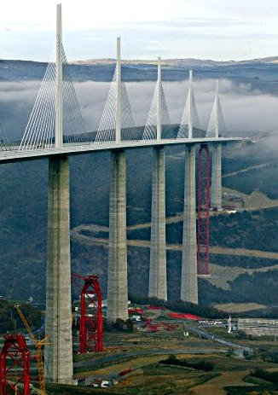
Paper 1: Listening, Reading and Writing
45% of AS level
1 hour 45 minutes exam paper
Done in June
Individual student control of audio file.
Translation from TL into English

Slide 3
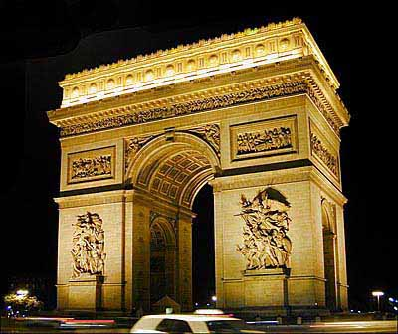
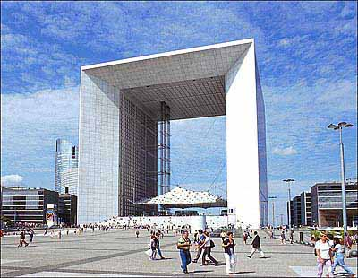
Paper 2: Writing
1 hour 30 minutes
Done in June
25% of AS
Study of one film
Translation into TL (grammar)
Essay requiring a critical response to the film

Slide 4
French set films
Au revoir les enfants
La Haine
L’auberge espagnole
Un long dimanche de fiançailles
Entre les murs
Les 400 coups

Slide 5
Paper 3: Speaking test
30% of AS marks
12-14 minutes test + 15 mins preparation
Discussion of the 2 themes based on a stimulus card
Done in April/May
Conducted by class teacher
Themes
Aspects of the society of the TL country
Artistic culture of the TL country

Slide 6

A-level 1st year topics
1. Aspects of French-speaking society: current trends
The changing nature of family
The ‘cyber-society’
The place of voluntary work
2. Artistic culture in the French-speaking world
A culture proud of its heritage
Contemporary francophone music
Cinema: the 7th art form
3. Grammar
4. One film

Slide 7
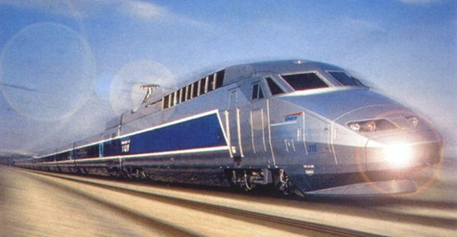
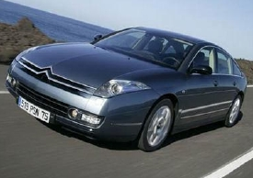
A-level year 2 French
Paper 1: Listening Reading and translation
Paper 2: Writing
Paper 3 Speaking

Slide 8
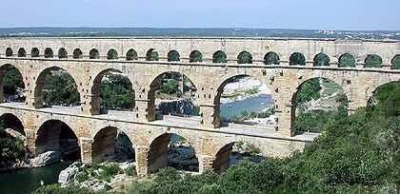
Paper 1: Listening, reading and translation
40% of A level marks
2 hours 30 minutes written exam
Done in June of Year 13
Individual student control of CD
Translations into English and into the TL

Slide 9

Paper 2: writing
30% of A level marks
2 hour exam
Done in June of Year 13
2 essays on the set film and text (minimum 300 words)

Slide 10
French-set literary texts
Molière Le Tartuffe
• Voltaire Candide
• Maupassant Boule de suif et autres contes de la guerre
Camus L’étranger
• Françoise Sagan Bonjour tristesse
• Claire Etcherelli Elise ou la vraie vie
• Joseph Joffo Un sac de billes
• Faïza Guène Kiffe kiffe demain
• Philippe Grimbert Un secret
• Delphine de Vigan No et moi

Slide 11
Paper 3:Speaking test
30% of A-level marks
21-23 minutes including 5 minutes preparation
Discussion of stimulus card (5-6 mins)
Presentation (2 mins) – followed by discussion of individual research project (9-10 mins)
Conducted by class teacher.
Marked by AQA examiner.

Slide 12

A Level topics
Aspects of French Speaking society: current issues
Positive features of a diverse society
Life for the marginalised
How criminals are treated
Aspects of political life in the French speaking world
Teenagers, the right to vote and political commitment
Demonstrations, strikes-Who holds the power?
Politics and immigration
Grammar
Study of 1 literary text and 1 film in the first year
Individual research topic for the oral test

Slide 13
Classroom and homework activities
Discussion Reading aloud
Pair/group work Translating
Listening to CD Summarising
Watching film Essay writing
Grammar exercises online activities
Vocabulary building Assistant lesson
Oral presentations Reading tasks

