Slide 1



BTEC/CTEC Options
Rationale:
  Greater flexibility with subject combinations, e.g. 2 A Levels plus one 360GLH BTEC etc.
  Appeal to students that do not want to commit to 3 A Levels
  Potential ‘tapping in’ to particular talents/initial career aspirations
https://qualifications.pearson.com/en/qualifications/btec-nationals/btec-nationals-2016.html
https://www.ocr.org.uk/qualifications/cambridge-technicals/

Slide 2
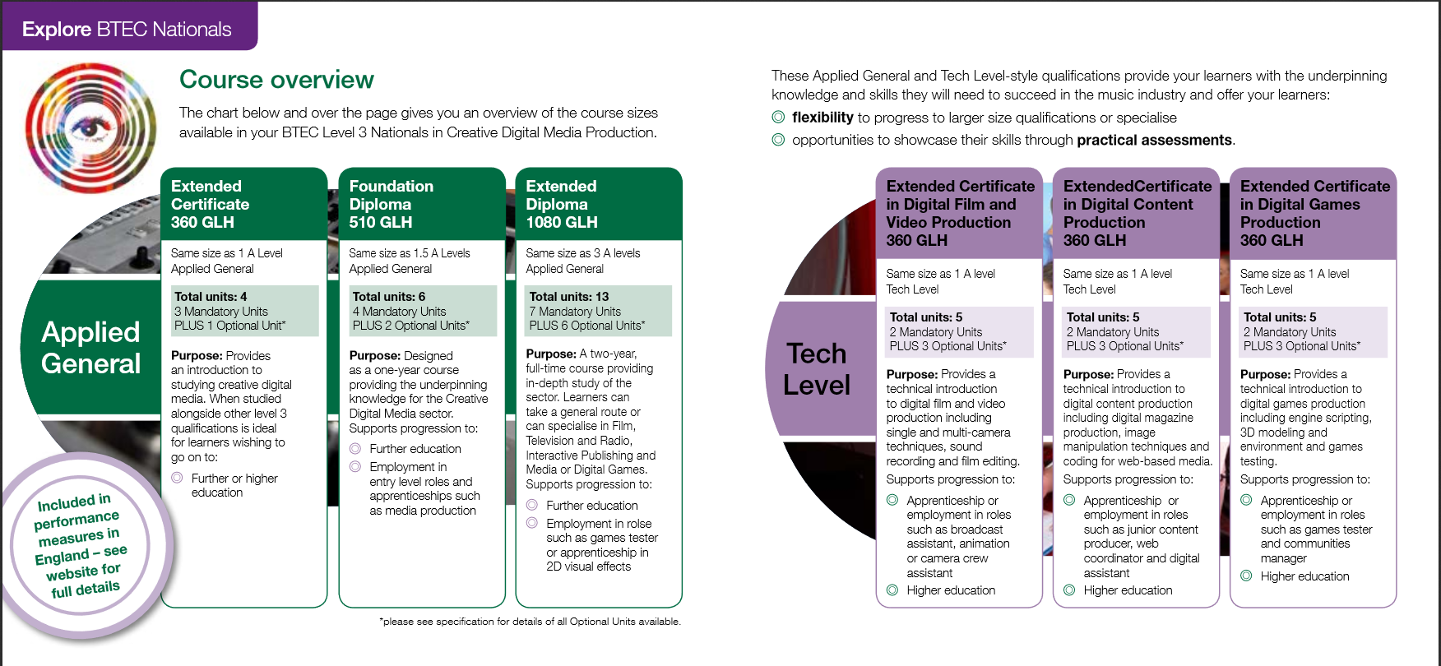
Creative Digital Media Production (2016)

Slide 3

Click
Image to
Link
To subject
website

Slide 4
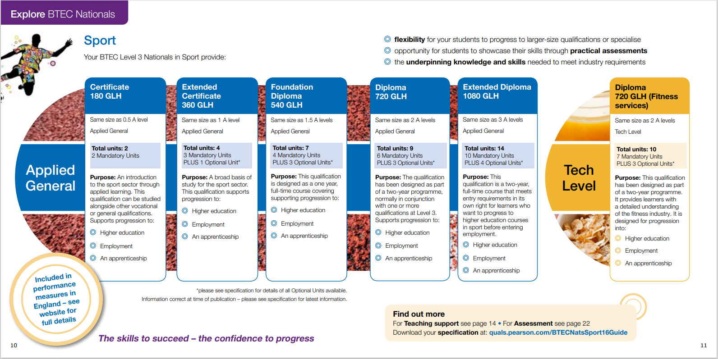

Slide 5
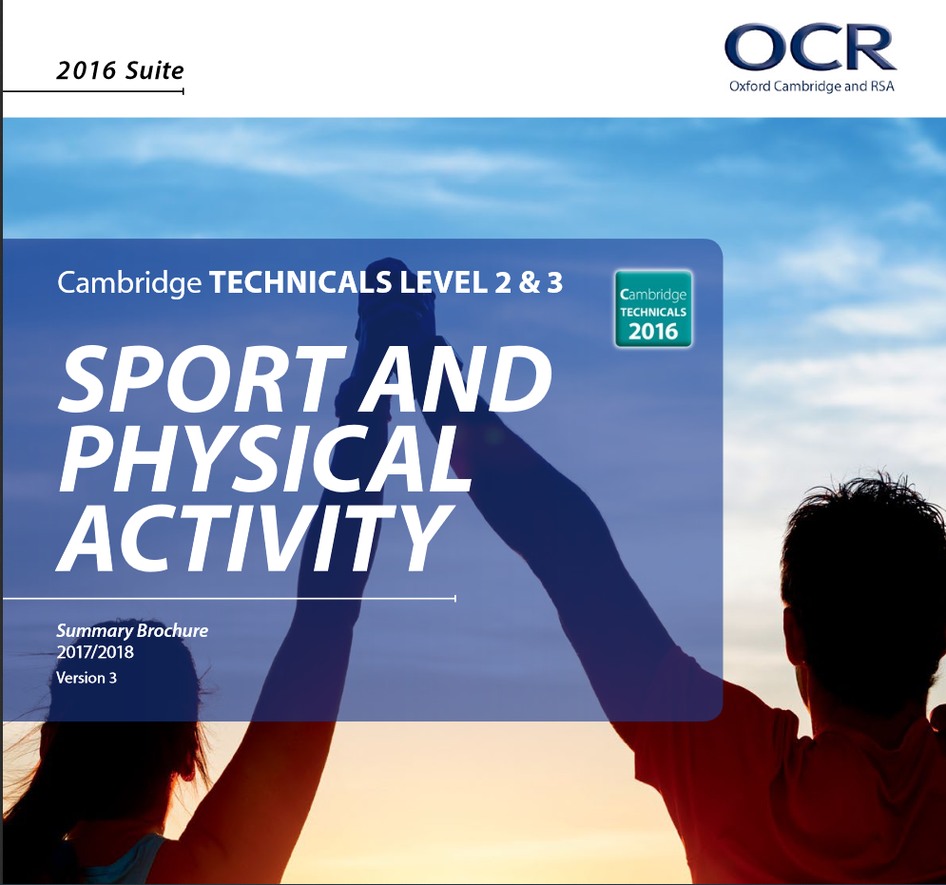
Click
Image to
Link
To subject
website

Slide 6
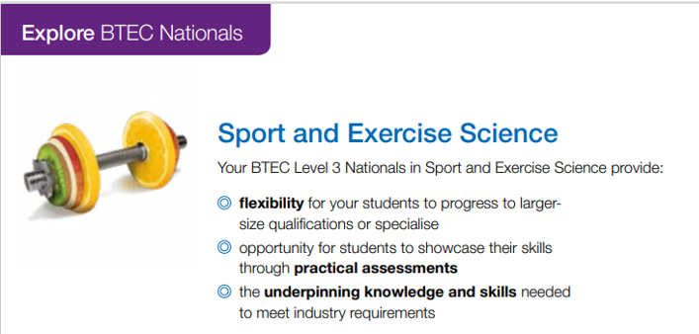
Everyone taking this qualification will study three mandatory units, covering the following
content areas:
functional anatomy
applied sport and exercise psychology
coaching for performance and fitness.
You will also choose one unit from a small range of optional units, which have been designed to support progression to a variety of sport courses in higher education, and to link with relevant occupational areas. This will allow you to choose a specific specialist area in which you wish to develop your skill.
The qualification carries UCAS points and, when taken alongside other level 3 qualifications, is recognised by higher education providers as contributing to admission requirements to many relevant sport science or related courses, for example a:
BSc (Hons) in Sport and Exercise Science, if taken alongside A levels in Biology and Psychology
BSc (Hons) in Sport Psychology, if taken alongside BTEC Applied Science and A Level Psychology
BA (Hons) Applied Sport Science, if taken alongside A Level Maths and a BTEC in Applied Science.
The sport and exercise science sector largely recruits at graduate level. The sector has become more important as the link between physical activity and health is recognised. Jobs in the sector can be found in universities, in large sporting organisations, public and private enterprises, as well as in local authorities, or schools and colleges.
Related areas such as sports development, performance analysis and research also provide employment opportunities. Who is this qualification for? The Pearson BTEC Level 3 National Extended Certificate in Sport and Exercise Science qualification for post-16 students wanting to continue their education through applied learning, and who aim to progress to higher education and ultimately to employment, probably in the sport sector.

Slide 7
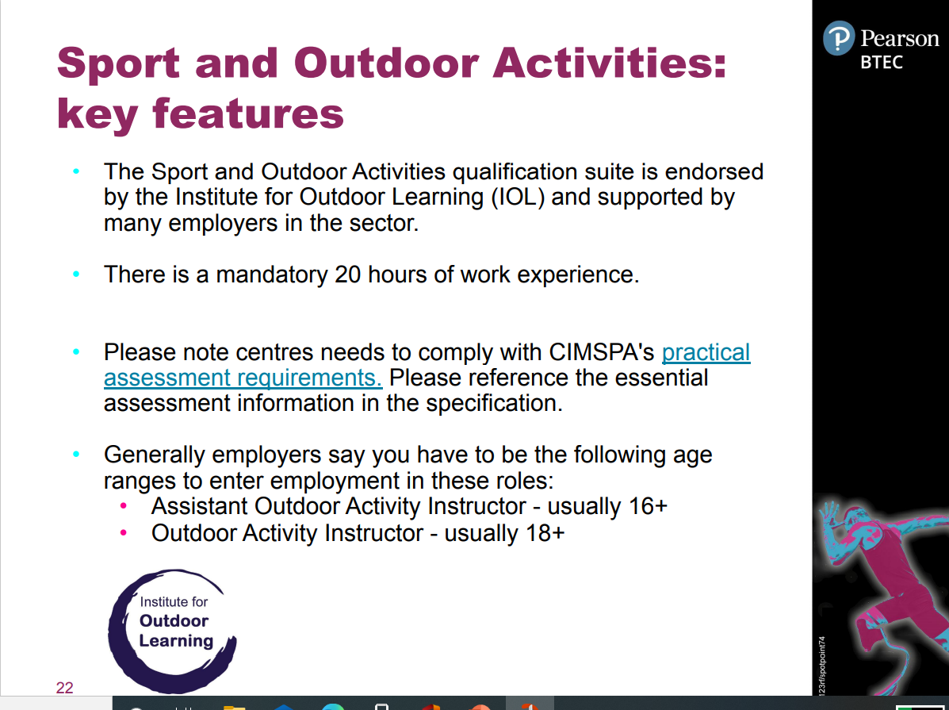

Slide 8


Slide 9

Click
Image to
Link
To subject
website

Slide 10


Slide 11
