Slide 1
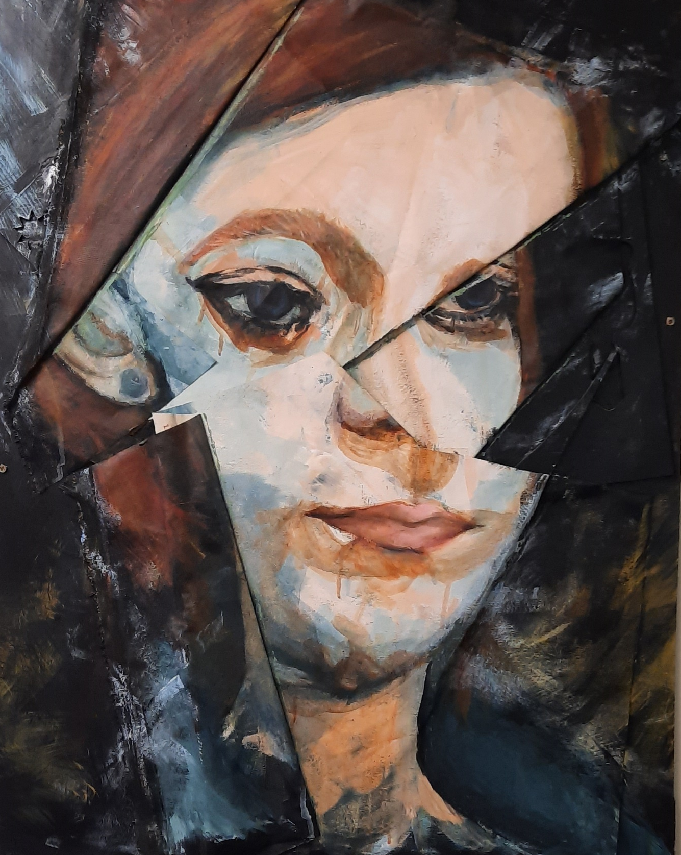
Choose Beechwood, to path your way to success as an artist?

Slide 2
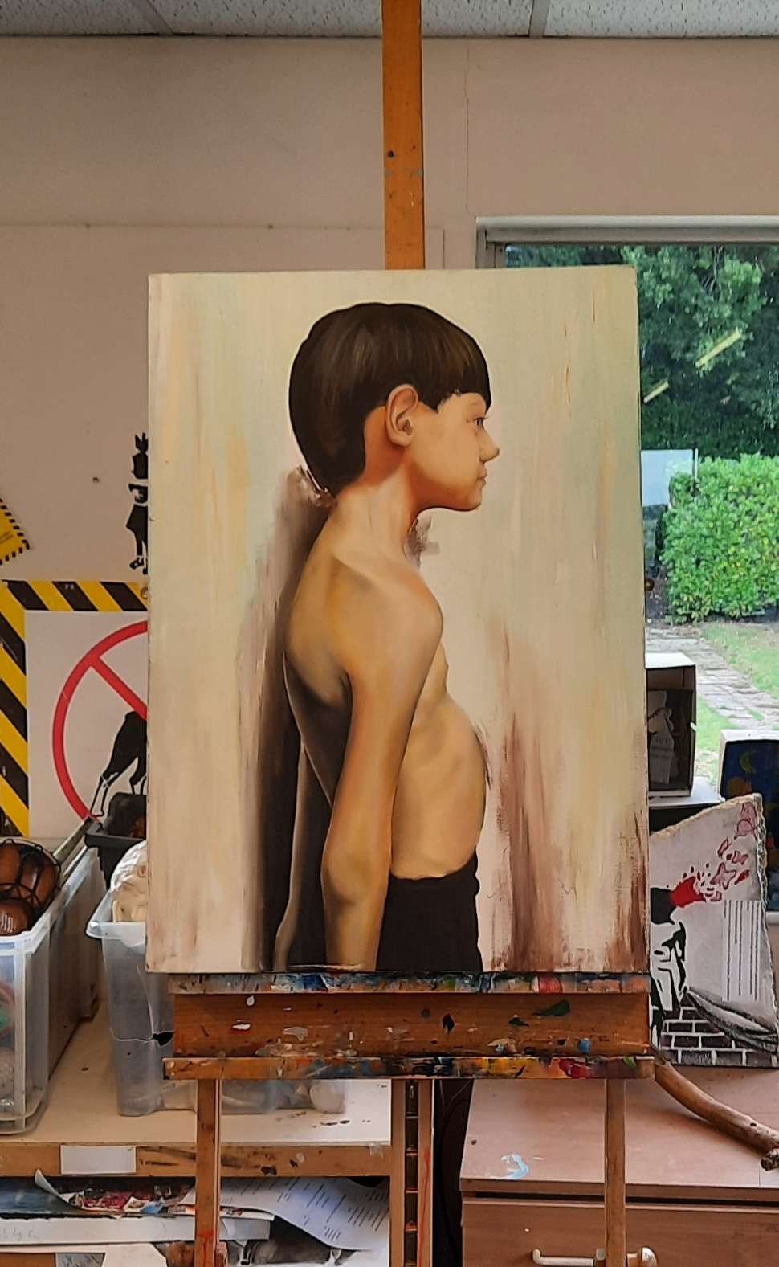
Art will take on a new meaning, where individual needs will be meet to path the way to achievement.
Work scrutiny takes place every 5 weeks to ensure pupils are producing outcomes reflective of the level and time given to the subject.
A specific area and space is given to accommodate each pupils needs within the art room.
Emphasizing the importance of investigation and drawing from life. Building up the skills required to take the subject onto the next level with confidence.

Slide 3
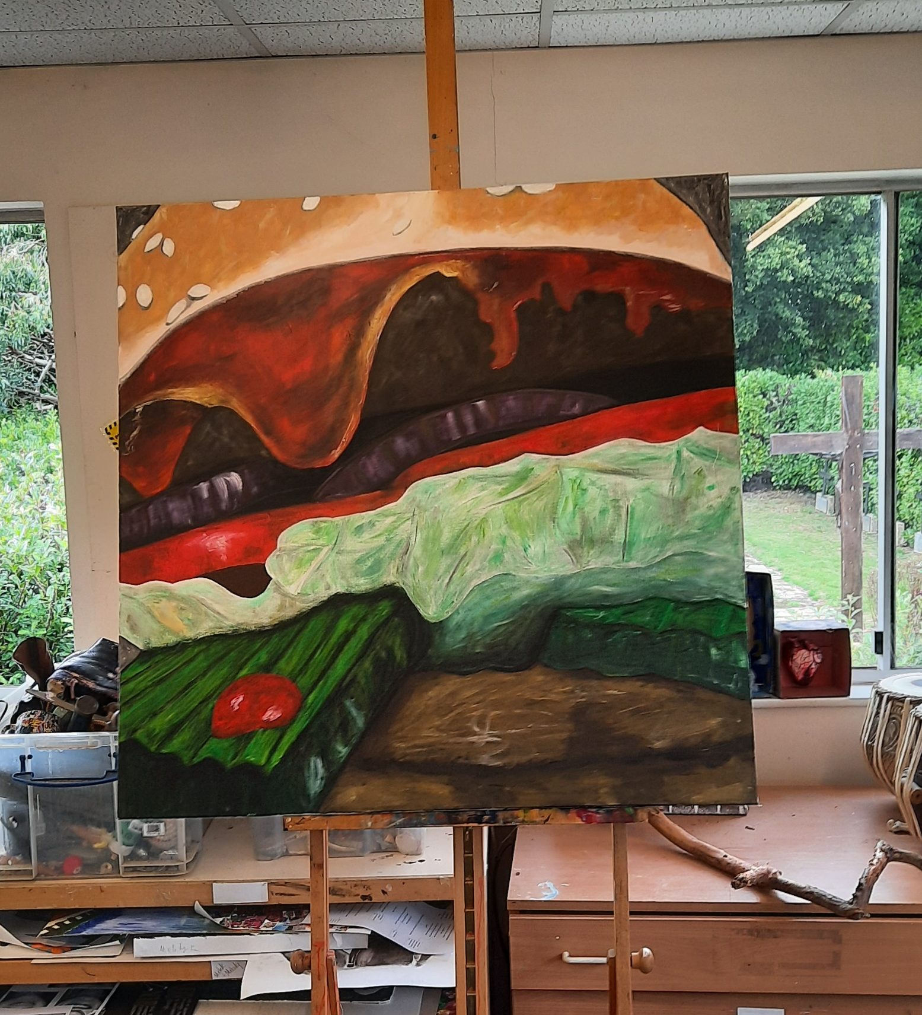
How will I study?
With the absence of the ‘As’ examination pupils will have the opportunity to really explore the subject, experimenting with new media, taking part in life drawing classes, visiting places to investigate and generally have fun! Without the worry of an impending examination.
In January of Year 12 you will start to focus on the personal project, using the experiences from the start of the course to decide how to proceed. This will take place with guidance from your teacher, your needs will be prioritized throughout this period, our aim is, ‘ As you grow in knowledge, you grow in skill and confidence’.

